Slide 1

Analyzation of Financial Data on Predicting Net Income of a Building Services Company from 2019-2023
Shelley Wright

Slide 2
Data Cleaning Process

Slide 3
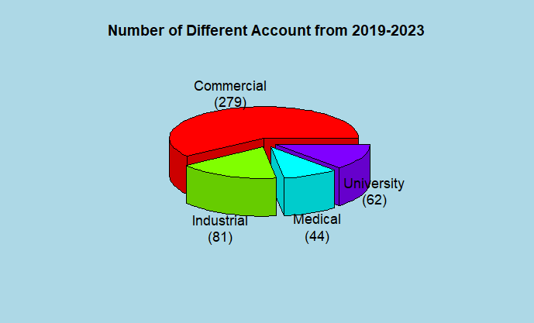

Slide 4
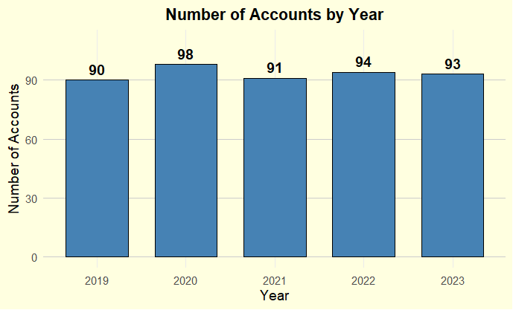

Slide 5
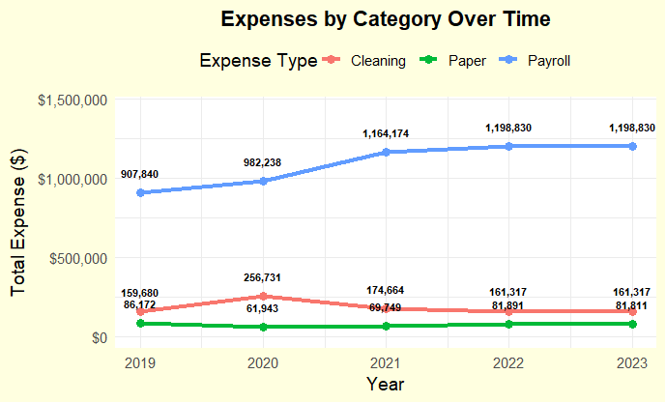

Slide 6
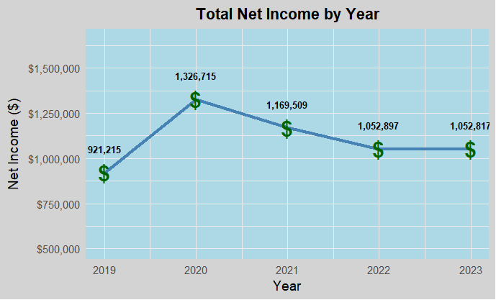

Slide 7
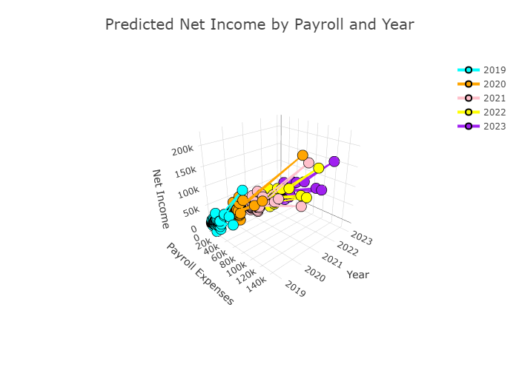

Slide 8
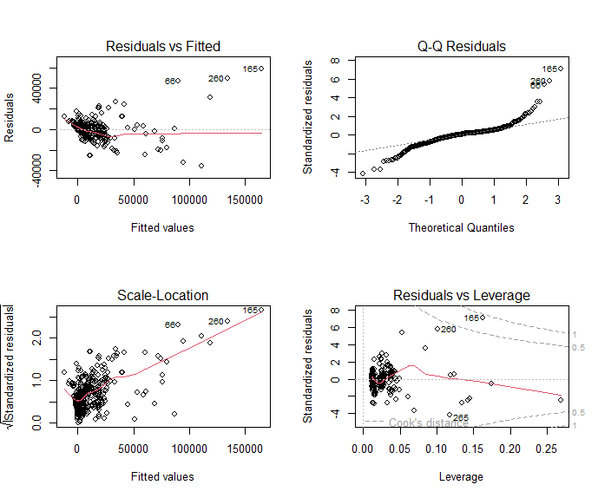

Slide 9
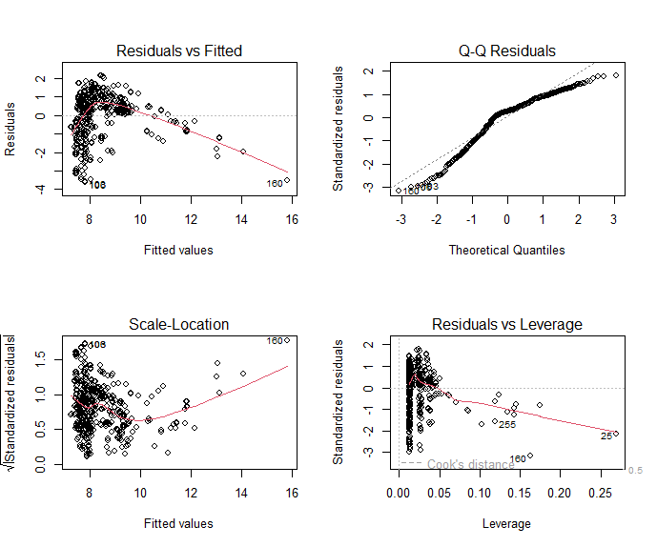

Slide 10
Term | lm() Estimate | rlm() Estimate | Interpretation
(Intercept) | 7.856 | 7.970 | Slightly higher baseline in robust model
Year2022 | -0.393 (p = .03) | -0.331 (marginal) | Both suggest ↓ Net Income in 2022
Year2023 | -0.372 (p = .04) | -0.318 (marginal) | Robust model softens the drop
Class_LabelUniversity | 0.560 (p = .001) | 0.514 (strong) | Stronger positive effect remains
Payroll.Expenses | 4.13e-5 (p < .001) | stable and strong | Major positive association
Paper.Goods | 8.71e-5 (p < .001) | similar & strong | Still highly significant
Cleaning.Supplies | 6.88e-5 (p = .0015) | similar & strong | Still highly significant

Slide 11
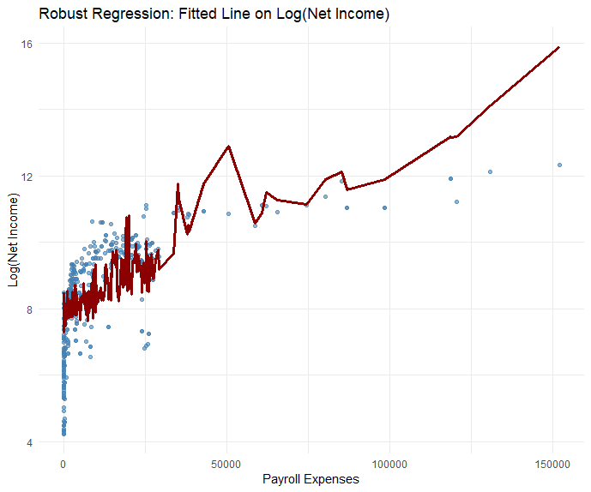

Slide 12
